Slide 1
SECURITY & SURVEILLANCE FOR TEACHERS AND STUDENTS
PIP2001 Capestone Project
Final Viva
Batch Number: CCS-G29
Roll Number | Student Name
20211CCS0065 | Chandrashekhar S
20211CCS0067 | Shubha K A
20211CCS0104 | Augustian P B
20211CCS0131 | Kavya Jaishree J
Under the Supervision of,
Ms. Soumya
Assisstant Professor
School of Computer Science and Engineering
Presidency University
Name of the Program: B. Tech
Name of the HoD: Dr. Anandaraj S P
Name of the Program Project Coordinator: Dr. Sharmasth Vali Y
Name of the School Project Coordinators: Dr. Sampath A K / Dr. Abdul Khadar A / Mr. Md Ziaur Rahman

Slide 2
Introduction
Educational institutions are increasingly integrating digital technologies for teaching, learning, and administrative purposes. While this transformation enhances efficiency and accessibility, it also raises significant challenges regarding network security, content monitoring, and access control. Without effective security systems, institutions are vulnerable to unauthorized access, cyberattacks, and misuse of online resources.
This project aims to address these challenges by developing a robust, user-friendly system that integrates modern technologies. By combining pfSense as a firewall, LDAP for authentication, MongoDB for data storage, and a dynamic URL filtering mechanism, the system ensures network security, simplifies policy management, and promotes safe internet usage. The project also provides teachers and administrators with an intuitive web interface to manage access control policies effortlessly, eliminating the need for technical expertise.

Slide 3
Literature Review
S.NO | METHOD | ADVANTAGES | LIMITATIONS
01 | Firewall GUI-Based URL Filtering | - Direct control - Advanced features - Centralized management | - Complex for non-technical users - Requires training
02 | Command-Line Interface (CLI) | - Full control - Flexible - Ideal for advanced users | - Non-intuitive - Prone to errors - Time-consuming
03 | Cloud-Based Filtering | - Scalable - Easy to deploy - Real-time filtering | - Reliant on internet - Limited on-premise control - Subscription costs
04 | Proxy-Based Filtering | - Centralized control - Customizable filtering | - Technical setup - Potential performance issues - Limited HTTPS support
05 | DNS-Based Filtering | - Simple setup - Low impact on performance | - Limited control - Lacks advanced features - Not ideal for enterprises

Slide 4
Literature Review(Cont.)
S.NO | METHOD | ADVANTAGES | LIMITATIONS
06 | Endpoint Security Software | - Integrated with device security - Consistent enforcement | - Resource-intensive - Less scalable for large networks
07 | Manual Whitelisting/Blacklisting | - Simple for small-scale networks | - Not scalable - Requires constant updates - Lacks flexibility
08 | Browser Plugins | - Easy to deploy on individual devices | - Lacks centralized control - Easily bypassed - Not suitable for large networks
09 | Machine Learning-Based Filtering | - Dynamic filtering - Real-time threat detection | - Expensive - Resource-intensive - Requires tuning

Slide 5
Existing Methods
Direct FMC Management (GUI-based)
Firepower Management Center CLI/Script-Based Configuration
IT Support/Help Desk Model
DRAWBACKS:
Lack of User-Friendliness for Non-Technical Users
Dependency on IT Departments
Risk of Misconfiguration
Scalability Issues
Limited Granular Control
Complex Policy Management

Slide 6
Objectives
Simplify Policy Management:
Offer a user-friendly platform that allows teachers and administrators to manage URL filtering and access control policies without technical expertise.
Improve Monitoring and Logging:
Ensure compliance by tracking user activity and logging changes to network policies.
Enhance Network Security:
Provide a secure and reliable solution for monitoring and controlling network traffic in educational institutions.
Promote Responsible Internet Usage:
Create a safe online environment by blocking harmful, inappropriate, or distracting content for students and teachers.

Slide 7
Proposed Method
The proposed method integrates key technologies to enhance network security and management in educational institutions. pfSense serves as the firewall, enforcing URL filtering to block harmful content. A user-friendly administrator webpage, built with Flask and Bootstrap, enables teachers and administrators to easily manage policies.
The MongoDB database stores policy configurations and activity logs, ensuring scalability and quick data access. LDAP provides secure user authentication and role-based access control, while REST APIs enable real-time communication and synchronization between system components.
Key Methods Used:
pfSense Firewall: Manages network traffic and enforces URL filtering.
Administrator Webpage: Simplifies policy management for non-technical users.
MongoDB Database: Stores configurations, logs, and activity data.
LDAP: Provides secure user authentication and role-based access control.
REST APIs: Facilitates real-time communication between components.

Slide 8
Methodology
The project follows a systematic methodology to achieve the proposed objectives:
Development of the Administrator Webpage:
Method: Web Interface for Policy Management
Description: A user-friendly webpage, built using Flask and Bootstrap, allows administrators and teachers to manage URL filtering policies easily.
Integration of pfSense Firewall
Method: Firewall Configuration and URL Filtering
Description: pfSense manages network traffic and enforces URL filtering, blocking harmful or unauthorized websites based on user-defined policies.
Database Integration with MongoDB
Method: NoSQL Database for Configuration and Logs
Description: MongoDB stores policy configurations, user activity logs, and system data, ensuring scalability and fast retrieval.

Slide 9
Methodology(cont..)
User Authentication through LDAP
Method: LDAP Authentication for Secure Access
Description: LDAP authenticates users and manages role-based access control, ensuring secure access to the system.
REST API Integration
Method: RESTful Communication for Real-Time Updates
Description: REST APIs enable real-time communication and synchronization between the administrator webpage, pfSense, MongoDB, and LDAP.

Slide 10
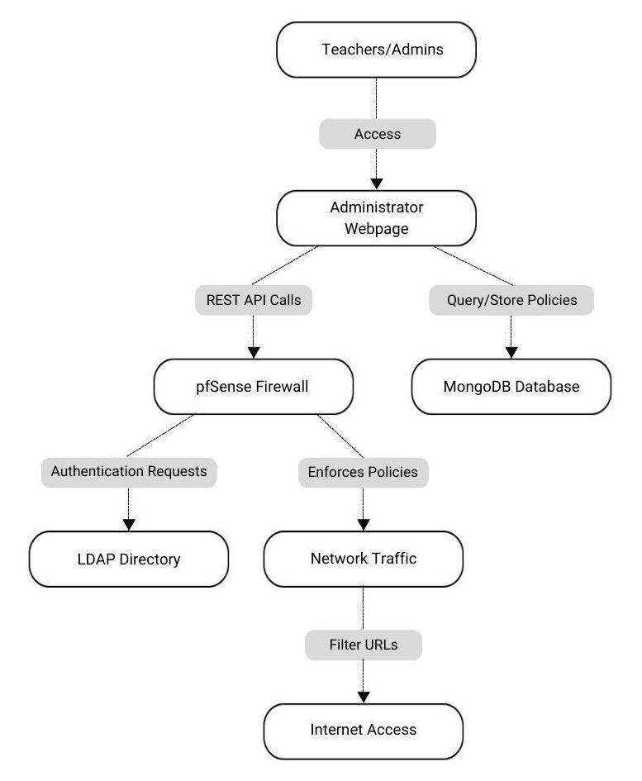
Architecture

Slide 11
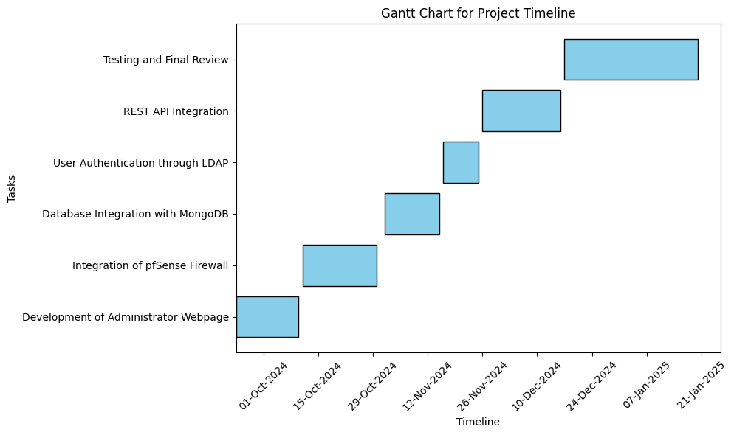
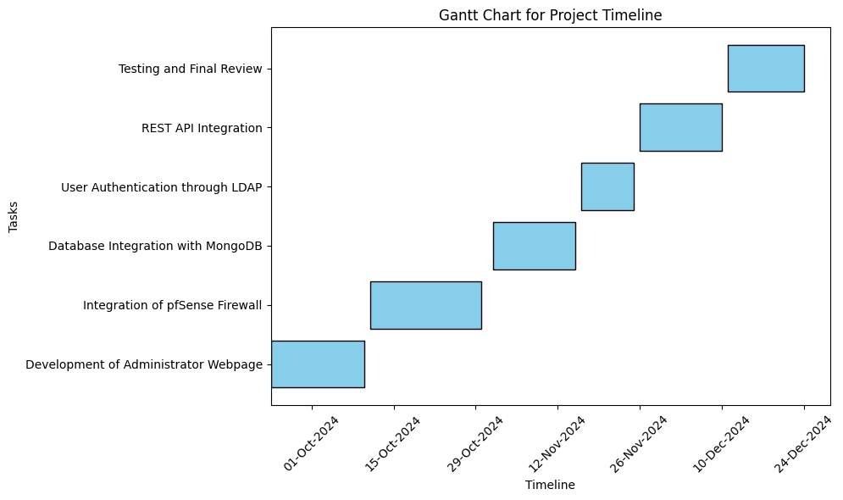
Timeline of Project

Slide 12
Outcomes
The proposed system is expected to deliver the following outcomes:
Enhanced Security: Protects the network from unauthorized access, cyber threats, and misuse.
User-Friendly Policy Management: Simplifies the process of managing URL filtering and access control policies through an intuitive web interface.
Improved Monitoring and Compliance: Tracks user activity and logs changes to policies, ensuring transparency and compliance with institutional rules.
Scalable and Adaptable Solution: Designed to accommodate the growing needs of educational institutions, with the flexibility to integrate additional features in the future.

Slide 13
Conclusion
This project provides a comprehensive solution for addressing the challenges of network security and access control in educational institutions. By integrating pfSense , LDAP, MongoDB, and a custom-built administrator webpage, the system ensures robust security while simplifying management tasks for teachers and administrators.
The proposed framework not only enhances network safety but also promotes responsible internet usage, creating a secure and productive environment for both students and educators. With its scalability and adaptability, the system can be customized to meet the unique needs of various educational institutions. Future work may include advanced features such as detailed analytics, machine learning-based filtering, and multi-institution scalability.

Slide 14
References
1] K. C. Patel and P. Sharma, "A review paper on pfSense – an open-source firewall introducing different capabilities & customization," Int. J. Adv. Res. Ideas Innov. Eng., vol. 3, no. 2, pp. 635-641, 2017
[2] V. R. Vyshnavi and A. Malik, "Efficient Way of Web Development Using Python and Flask," International Journal of Recent Research Aspects, vol. 6, no. 2, pp. 16-19, June 2019.
[3] D. F. Ferraiolo, J. A. Cugini, and D. R. Kuhn, "Role-Based Access Control (RBAC): Features and Motivations," National Institute of Standards and Technology, U.S. Department of Commerce, Gaithersburg, MD 20899, 2019(RBAC)
[4] Mohammed A Qadeer, Mohammad Salim, M Sana Akhtar, "Profile Management and Authentication using LDAP, " 2009 International Conference on Computer Engineering and Technology, pp.247-251, May 2014.
[5] Mohamed E. Elhamahmy , Mohamed M.A. Elgazzar, Abdel-Hamid M. Emara, "A Proposed Approach for Management of Multiple Firewalls Using REST API Architecture, " International Journal of P2P Network Trends and Technology ( IJPTT ), Vol. 9, Issue 5, Sep - Oct 2019.
[6] Riri Fitri Sari, Syarif Hidayat, "Integrating Web Server Applications With LDAP Authentication" Communications and Information Technologies, 2006. ISCIT '06. International Symposium on, 10.1109/ISCIT.2006.340053, October 2006
[7] Jakub Dalek, Bennett Haselton, Helmi Noman, Adam Senft, Masashi Crete-Nishihata, Phillipa Gill, Ronald J. Deibert, "A Method for Identifying and Confirming the Use of URL Filtering Products for Censorship, " IMC’13:Proceedings of the 2013 conference on Internet measurement conference, 23–25 October 2013, Barcelona, Spain.
[8] Nikhil Deshpande , Tejas Borade, "The Importance of Bootstrap in Front End Development, " International Journal of Research Publication and Reviews, Vol 3, no 6, pp 4176-4178, June 2022
[9] Ayush Jindal, Dr. VISHAL SHRIVASTAVA, Dr. AKHIL PANDEY, "International Journal of Research Publication and Reviews, " Vol 5, Issue 4, pp.2559-2562. April 2024

Slide 15

Project work mapping with SDG
This project directly supports Goal 4 (Quality Education) and Goal 9 (Industry, Innovation, and Infrastructure) by improving access to educational resources and making technology more user-friendly. It also aligns with Goal 16 (Peace, Justice, and Strong Institutions) by enhancing security, transparency, and accountability in digital environments. Indirectly, it touches on Goal 8 (Decent Work and Economic Growth) and Goal 10 (Reduced Inequalities) by improving workplace efficiency and access to technology for all staff members.

Slide 16
Thank You

